Slide 1

UNIVERSITY OF NOVI SAD, SERBIA
Laslo Šereš, UNS

Slide 2
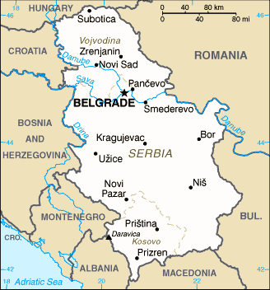
Public Universities in the Republic of Serbia
University of Novi Sad
University of Belgrade
University of Kragujevac
University of Niš
State University of Novi Pazar
University of Priština (currently located in Kosovska Mitrovica)
University of Arts
University of Defence

Slide 3
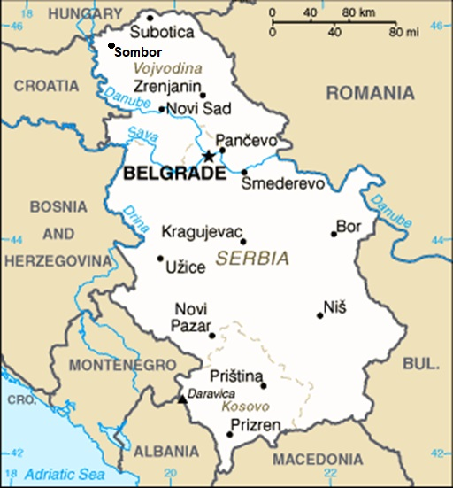
University of Novi Sad - General information
Comprehensive university providing higher education in nearly all fields of science
14 faculties and 3 scientific institutes in 4 cities:
  Novi Sad – 9 faculties, 3 scientific institutes
  Subotica – 3 faculties
  Zrenjanin – 1 faculty
  Sombor – 1 faculty

Slide 4
University of Novi Sad – Among the best in the world
Ranked between 500 and 1000 top universities in the world according to the Shanghai Ranking's Academic Ranking of World Universities (ARWU) 2018.
Ranked 697th among the 938 best universities in the world according to the CWTS Leiden Ranking (2018).
Among the top 5% of universities in the world according to the Webometrics Ranking of World Universities (July 2018):
  1096th in the world (competing with 28,000 universities)
  437th in Europe (competing with 6,000 universities) and
  43rd in the area of Central and Eastern Europe (competing with 3,000 universities)

Slide 5
University of Novi Sad – Among the best in the world
Among the top 150 in the field of Food Science and Technology, among top 300 in the field of Veterinary Sciences and among top 500 in the field of Chemical Engineering on the Shanghai Ranking's Global Ranking of Academic Subjects in 2018.
Among 200 and 250 best ranked universities in Agriculture & Forestry on the 2018 list of QS World University Rankings by Subject.

Slide 6
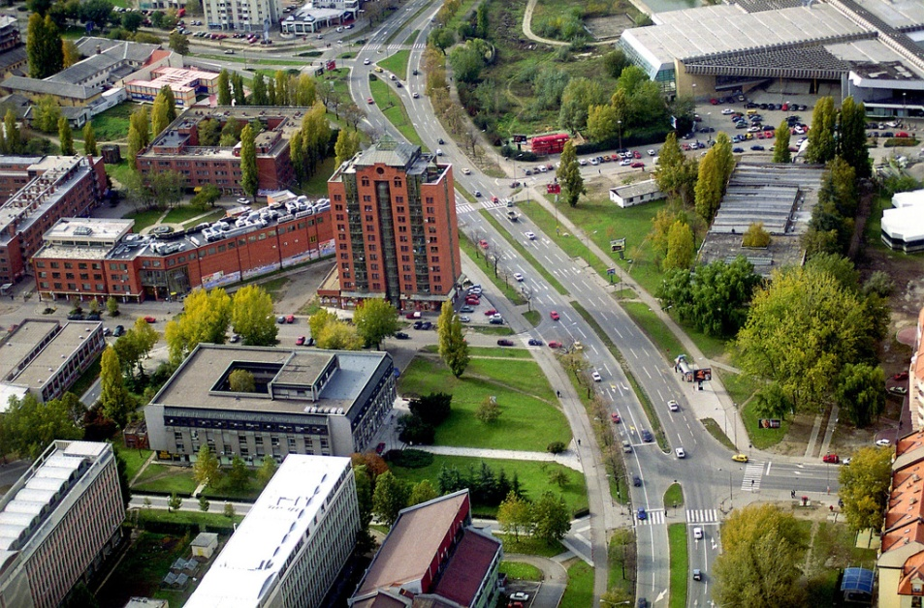
University of Novi Sad - General information
The University offers around 400 accredited study programs at the level of Bachelor, Master, Specialist and Doctoral studies, carried out at its Faculties and within its Centers for Interdisciplinary and Multidisciplinary Studies
50,000 students and 5,000 employees
  ≈ 42,000 – I level (Undergraduate and Integrated Academic Studies)
  ≈ 6,000 – II level (Master and Specialist studies)
  ≈ 2,000 – III level (Doctoral studies)
  ≈ 3,800 academic staff
  ≈ 1,300 administrative staff

Slide 7
University of Novi Sad - 14 faculties
In Novi Sad:
In Subotica:
In Zrenjanin:
In Sombor:
ACADEMY OF ARTS
FACULTY OF AGRICULTURE
FACULTY OF LAW
FACULTY OF MEDICINE
FACULTY OF PHILOSOPHY
FACULTY OF SCIENCES
FACULTY OF SPORT AND PHYSICAL EDUCATION
FACULTY OF TECHNICAL SCIENCES
FACULTY OF TECHNOLOGY
FACULTY OF ECONOMICS
FACULTY OF CIVIL ENGINEERING
TEACHER TRAINING FACULTY IN HUNGARIAN LANGUAGE
“MIHAJLO PUPIN” TECHNICAL FACULTY
FACULTY OF EDUCATION
ENGINEERING AND TECHNOLOGY
NATURAL SCIENCES
SOCIAL SCIENCES AND HUMANITIES
ARTS
MEDICAL SCIENCES

Slide 8



University of Novi Sad – Scientific Institutes
Institute of Lowland Forestry and Environment , Novi Sad
Scientific Institute of Food Technology, Novi Sad
BioSense Institute, Novi Sad

Slide 9
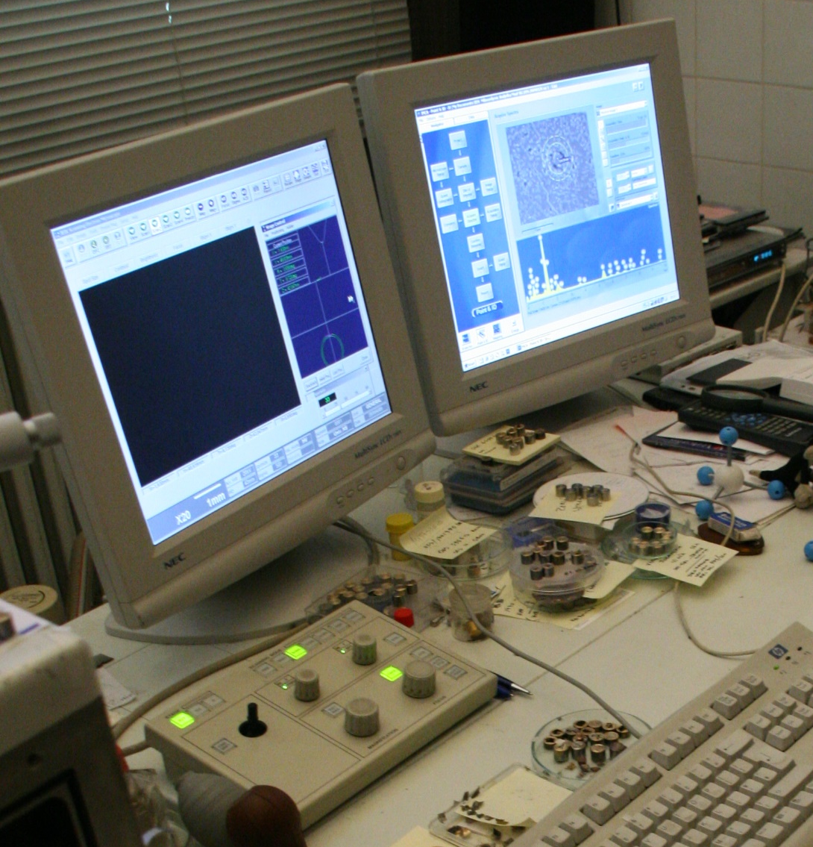
University of Novi Sad – Research and knowledge transfer
Fundamental research
Technological development projects
Integral and interdisciplinary research projects
All scientific and research fields: engineering and technology, natural sciences, medicine, social sciences, humanities and arts
International projects within the programs:
FP7, COST, EUREKA, SCOPES, SEE.ERA-NET, IPA, CEEPUS, TEMPUS, LLP, HORIZON 2020, TWINNING, CIP, ERASMUS MUNDUS, ERASMUS+, bilateral cooperation.

Slide 10
University of Novi Sad – Excellence in science and research
Centers of Excellence at the University of Novi Sad
Accredited Centers of excellence in the field of mathematics, vibro-acoustics and biotechnology.
The EU proclaimed the BioSense Institute one of the 30 research institutions in Europe with the greatest potential in the field of biotechnologies. Its project ANTARES, carried out within the program Horizon 2020, was best ranked in Europe in 2016.

Slide 11
University of Novi Sad – Knowledge transfer
Around 150 start-up and spin-off companies founded
Mainly in the IT sector
Employing young engineers who graduated from the University of Novi Sad
Some of these companies implement projects for large international corporations and have contributed to Novi Sad becoming recognized internationally as a “Software Valley”.

Slide 12
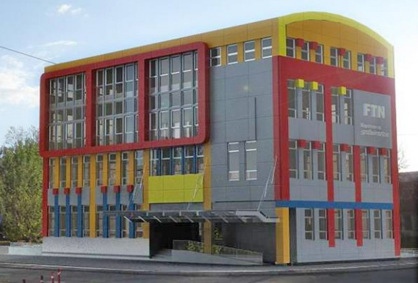
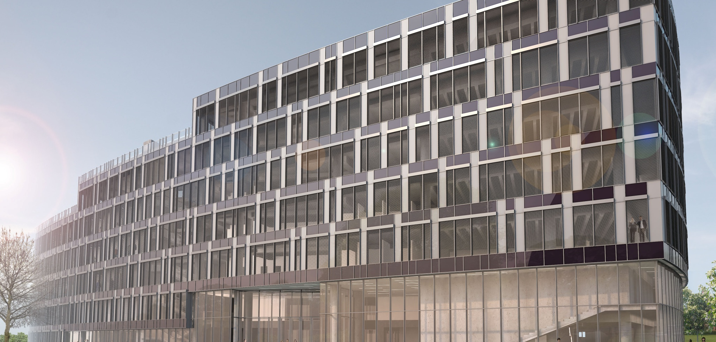
University of Novi Sad – New scientific and technology park
PHASE 1:
Laboratories
/ done /
2,150 m²
PHASE 2:
Technology Park
/ under construction /
29,000 m²

Slide 13
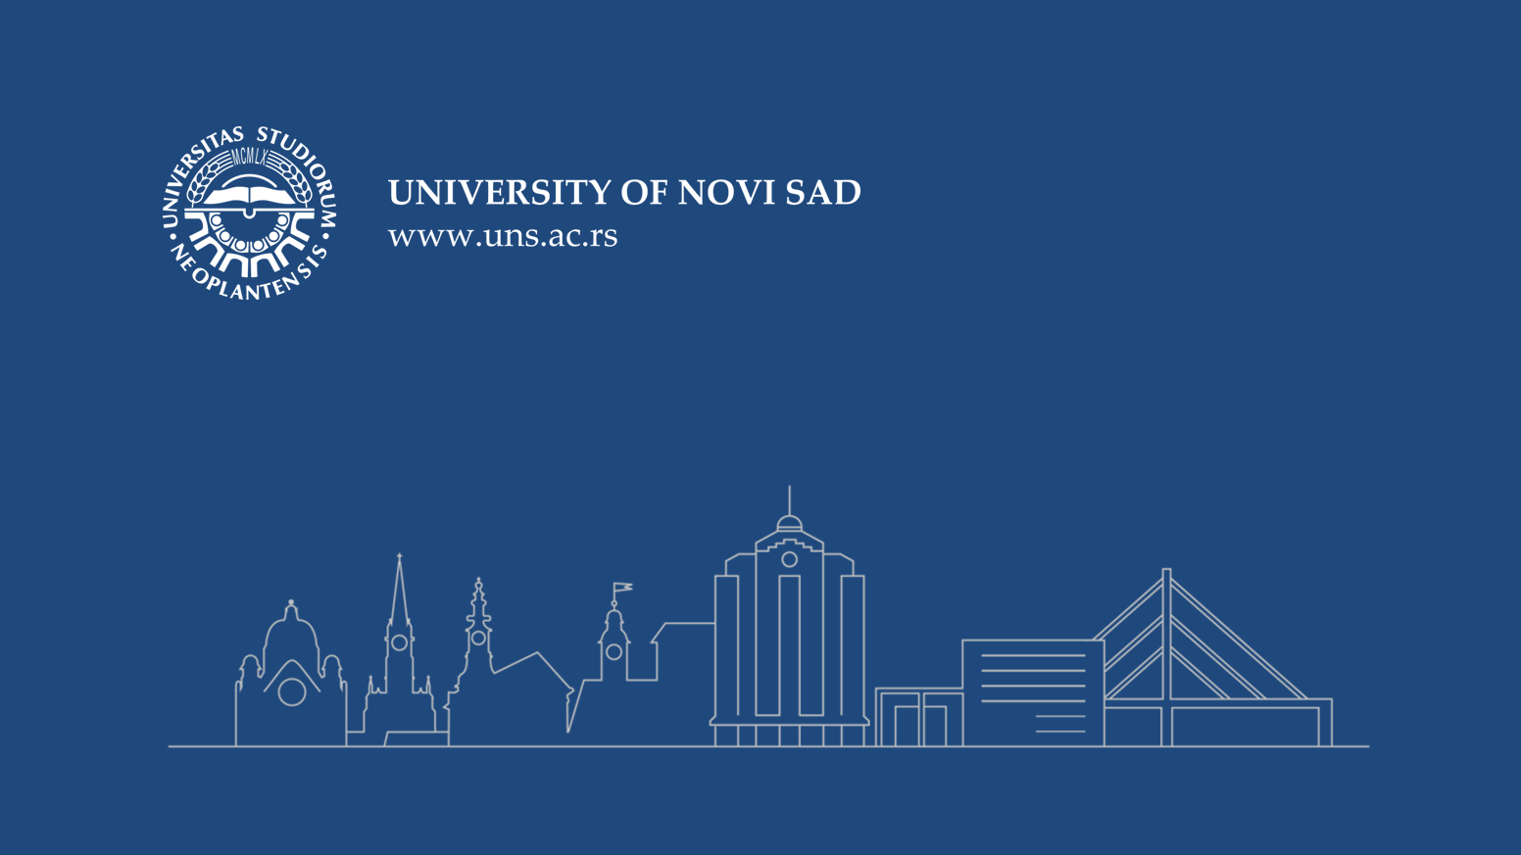
THANK YOU FOR YOUR ATTENTION!

