Slide 1
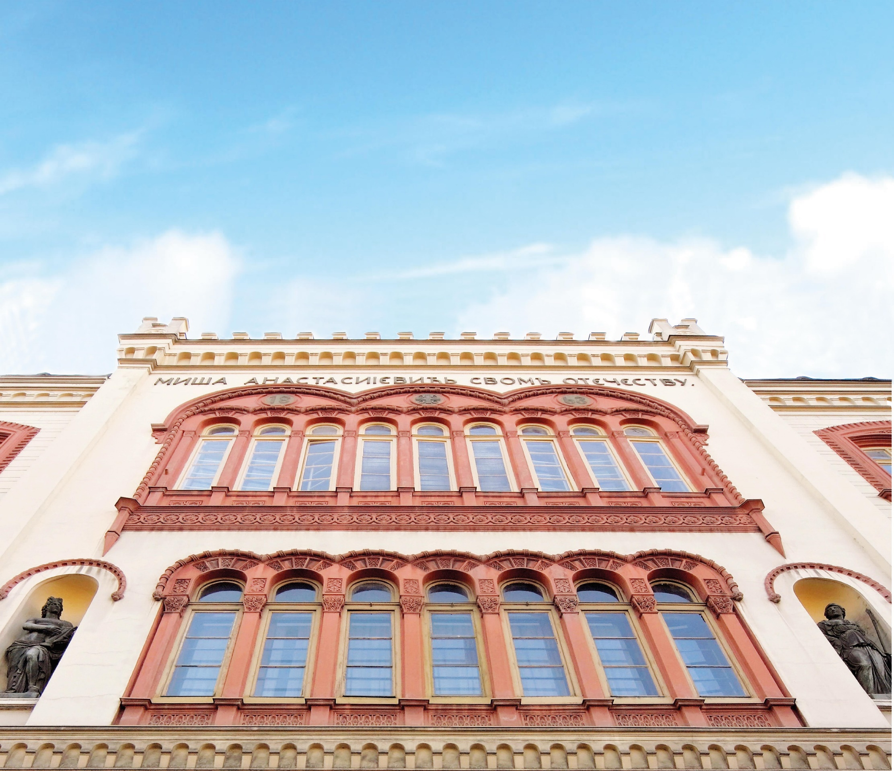

University of Belgrade

Slide 2
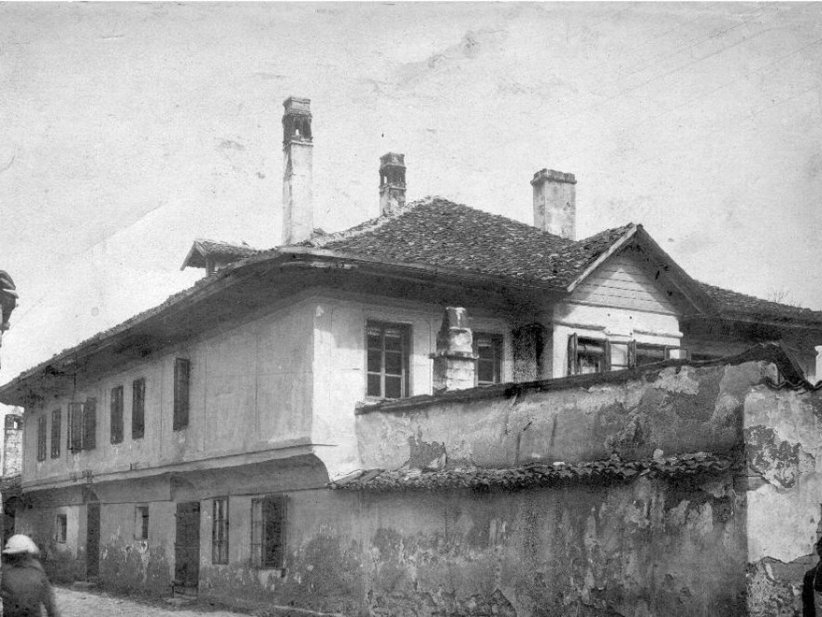
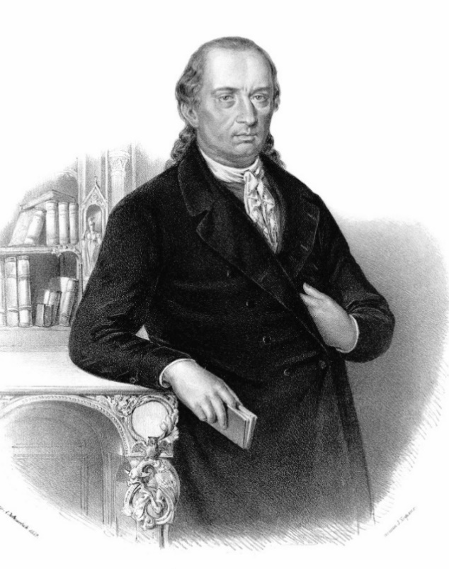
The oldest University in Serbia,
founded in 1808 by Dositej Obradović

Slide 3
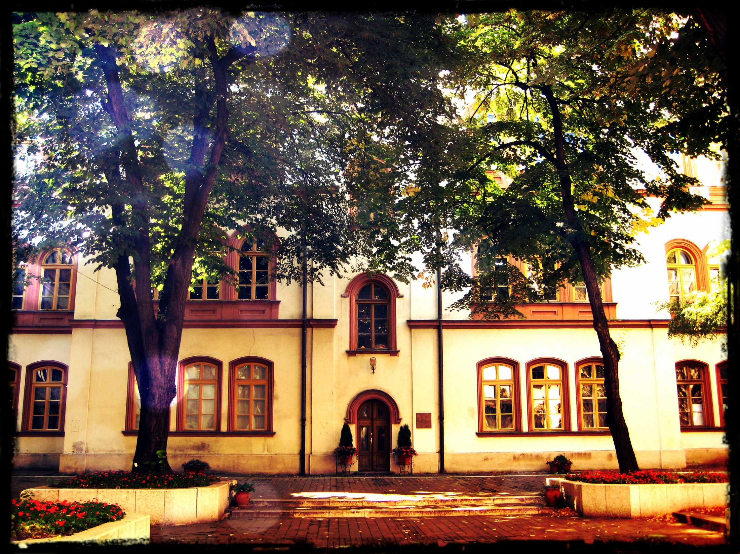
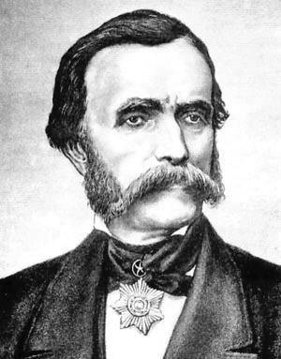
Main building
was built by Captain Miša Anastasijević in 1863 and donated to the University

Slide 4

Facts & Figures
31 Faculties
11 Research Institutes
13 Centers
University Library
325 Study Programs

Slide 5
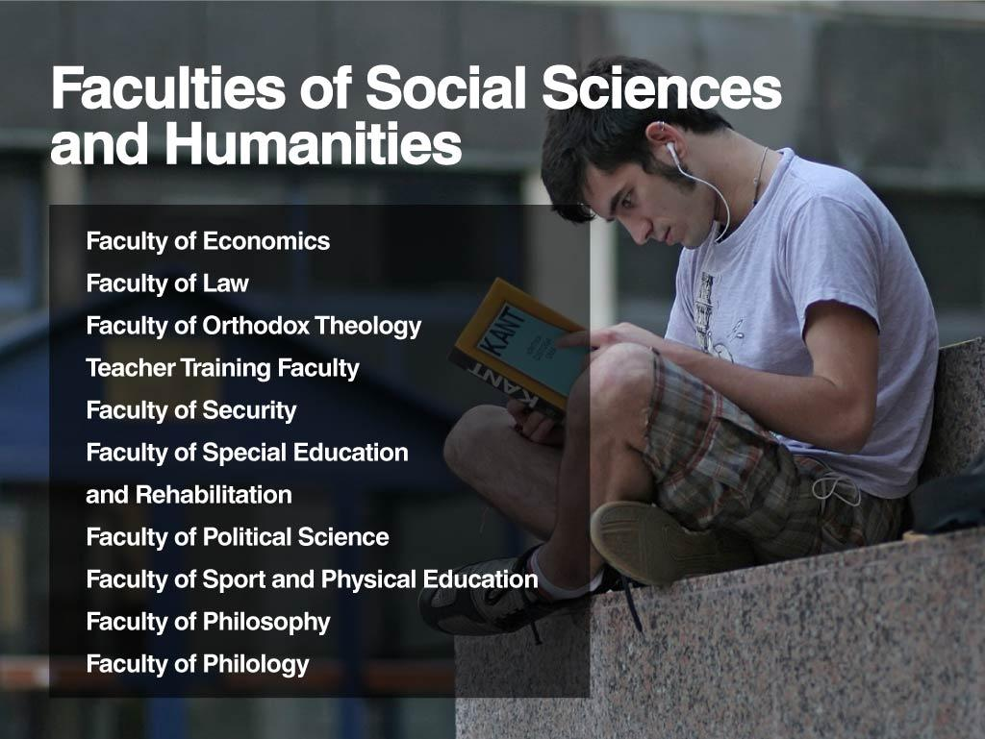

Slide 6
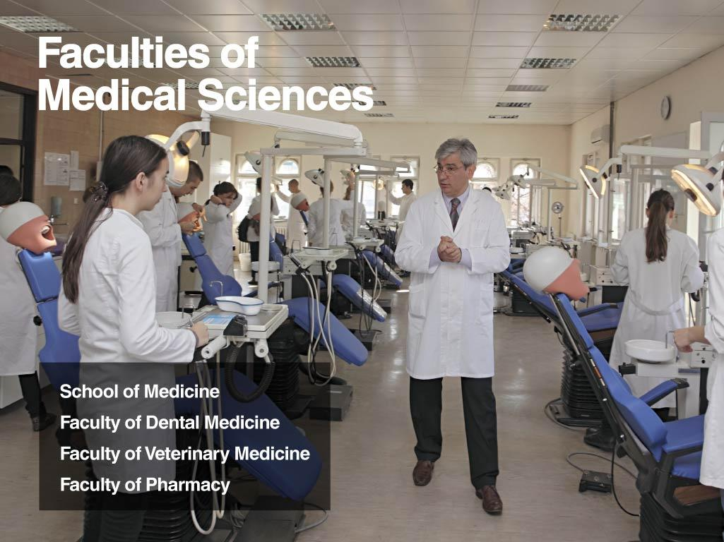

Slide 7
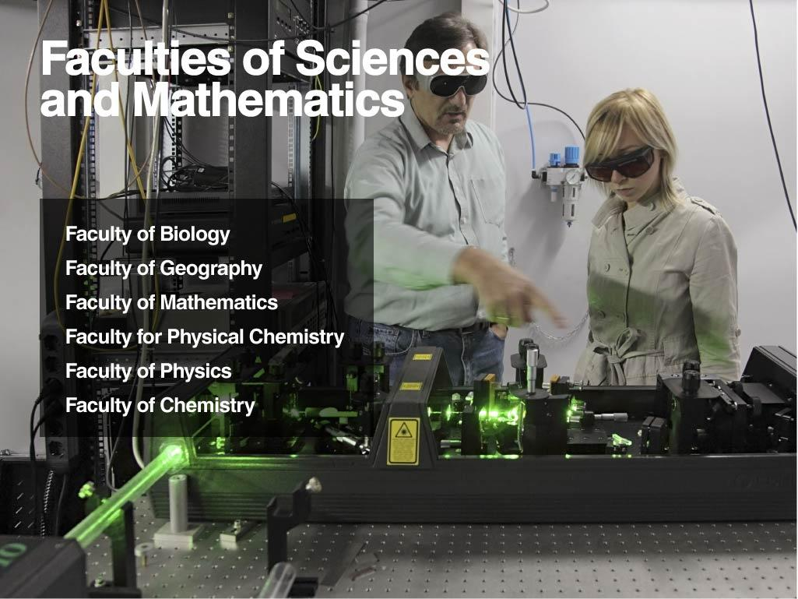

Slide 8
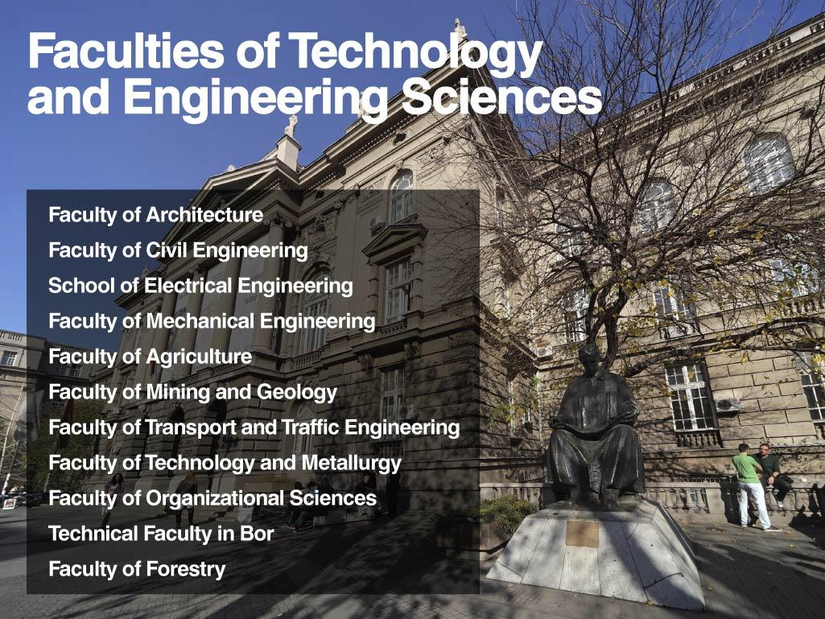

Slide 9
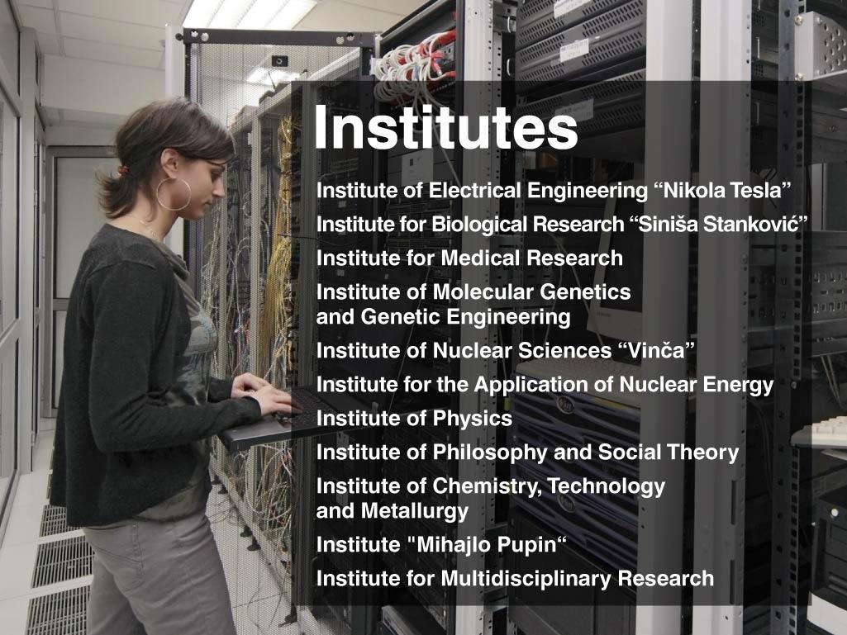

Slide 10
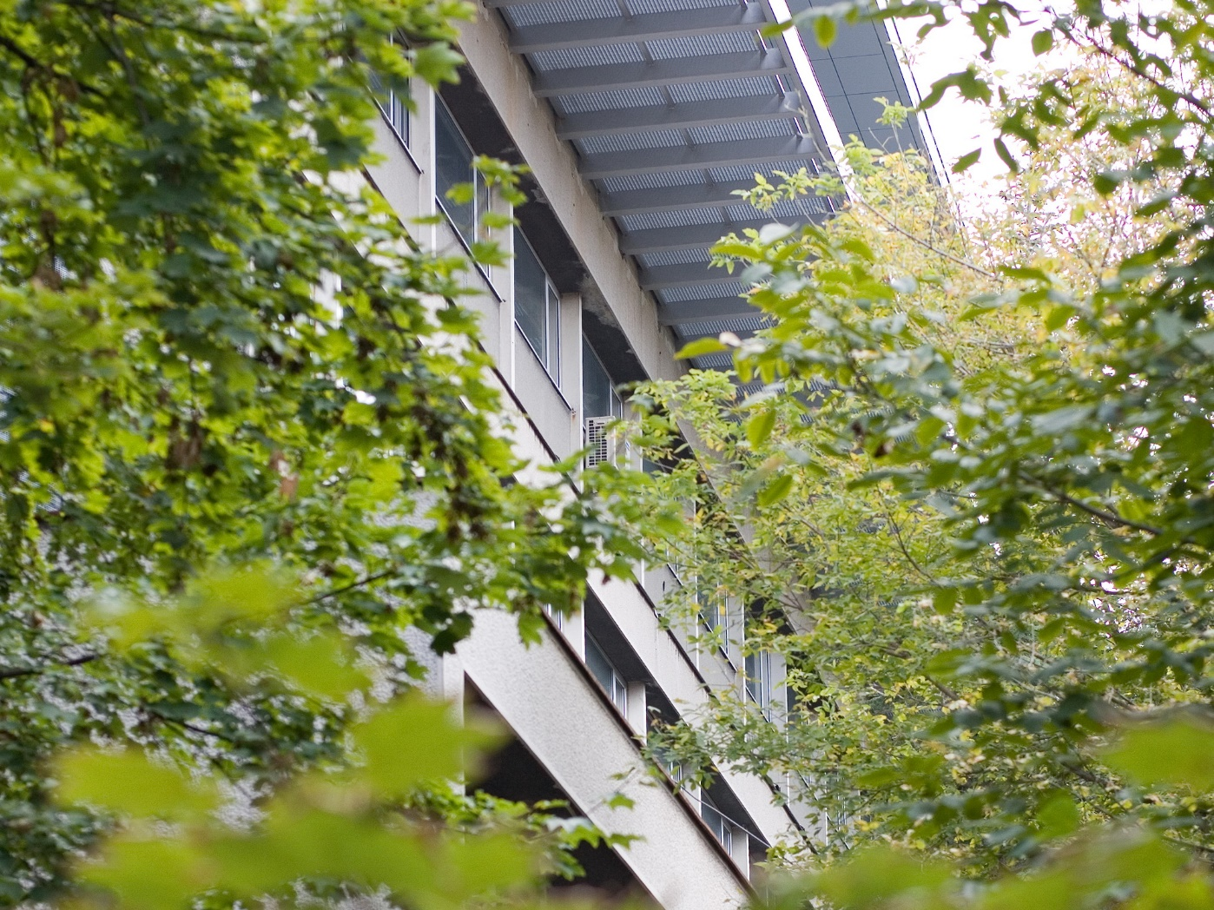
Centers
Information Center
Computer Center
Center for Career Development
Center for Technology Transfer
Center for Strategic Management
Center for Students with Disabilities
Center for Quality Insurance
Centre for Lifelong Learning
The Joint Japan-Serbia Center for the
Promotion of Science and Technology
Center for E-learning and Distance Education
Centre for EU Public Policies
Sports Center

Slide 11
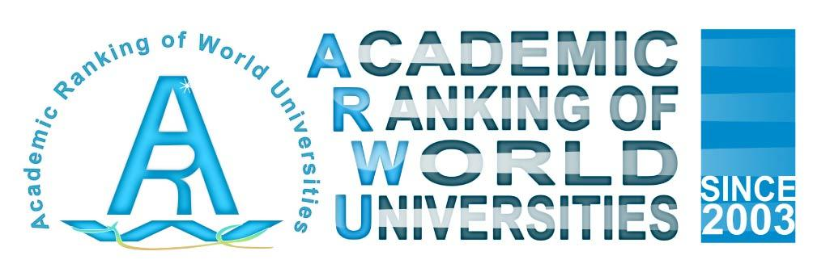
Since 2013 the University of Belgrade is ranked on the Academic Ranking of World Universities (Shanghai ranking)
Currently amongst TOP 300 universities

Slide 12

