Slide 1


University of Niš
KA2 – Capacity building in the field of Higher Education
ADA Kick-off meeting
26-27th November 2018, Novi Sad
Marija Dzunic, UNI representative

Slide 2
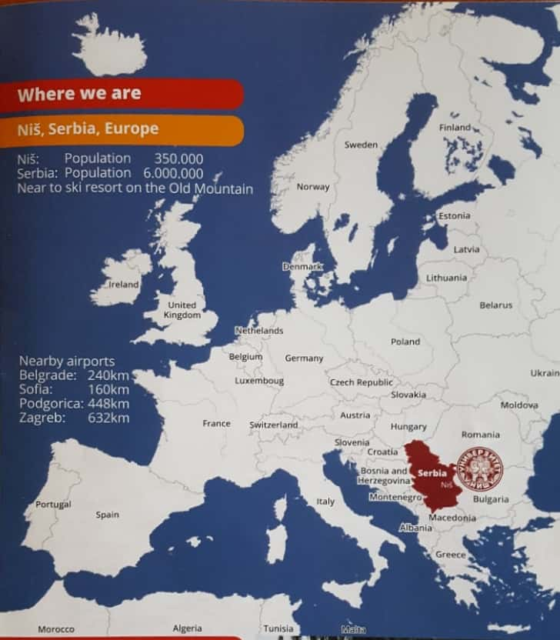
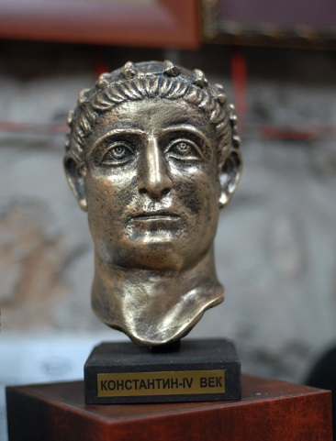
The city of Niš
Ancient gateway between the East and the West
Birthplace of Constantine the Great, Roman Emperor
Naiussus – the City of Fairies

Slide 3
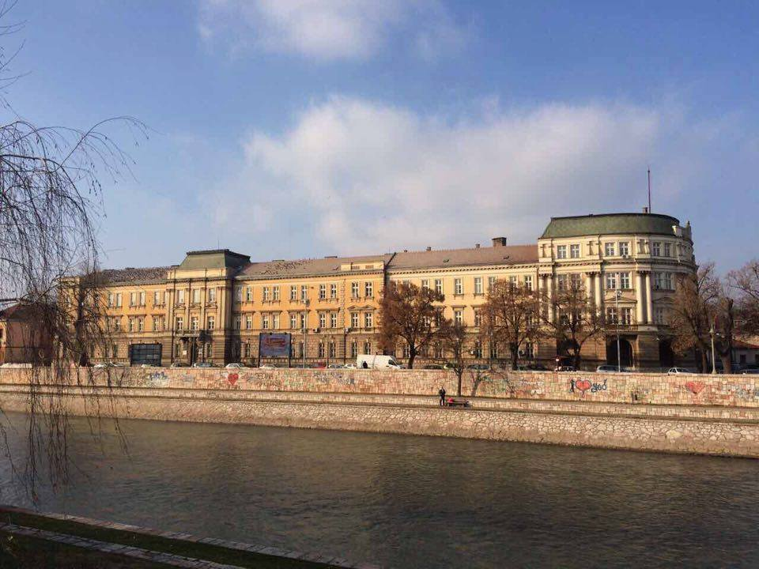
The University building - Banovina

Slide 4
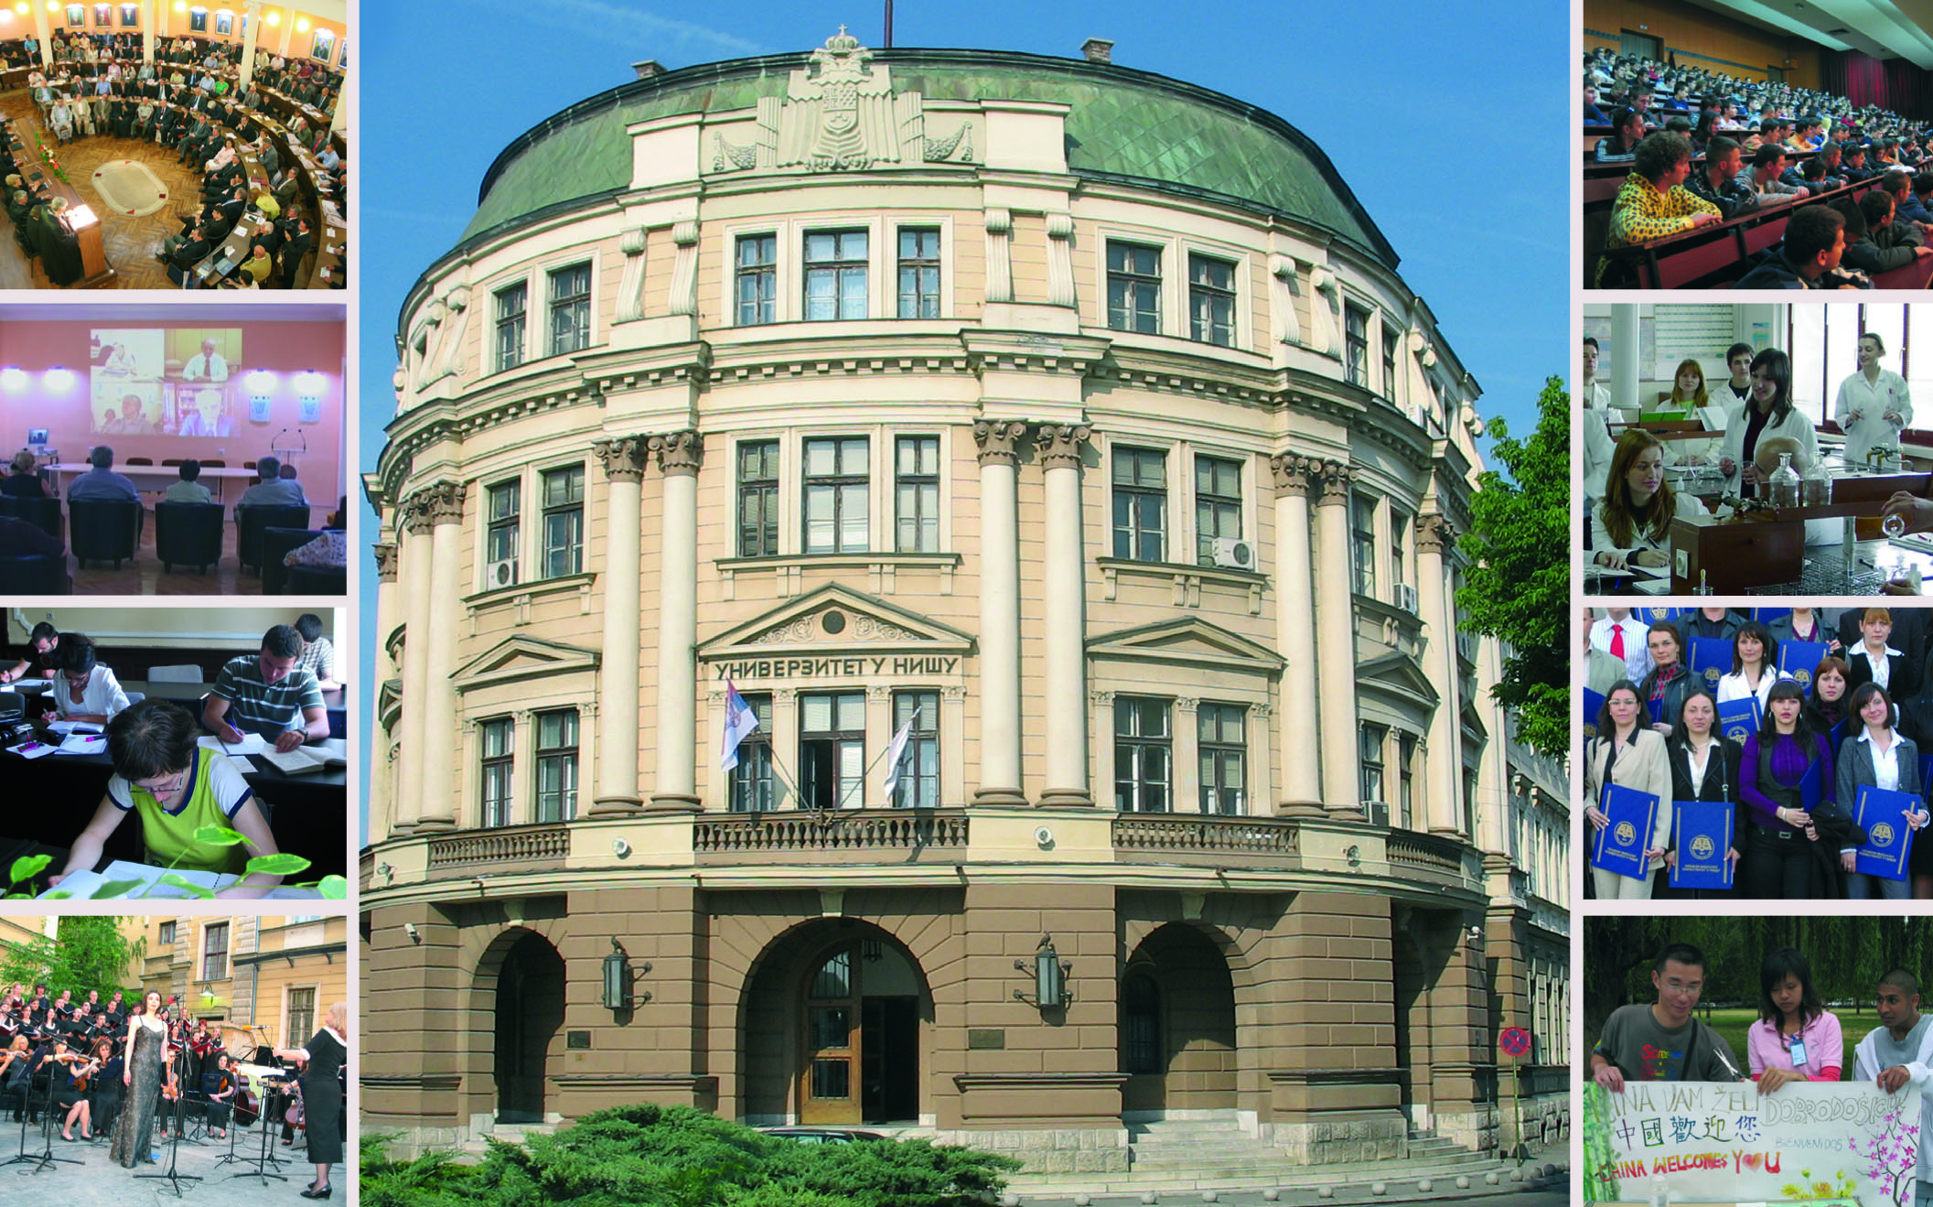
Built in the late 19th century
District Court
District Administration
Seat of the Morava County
1967 – University

Slide 5
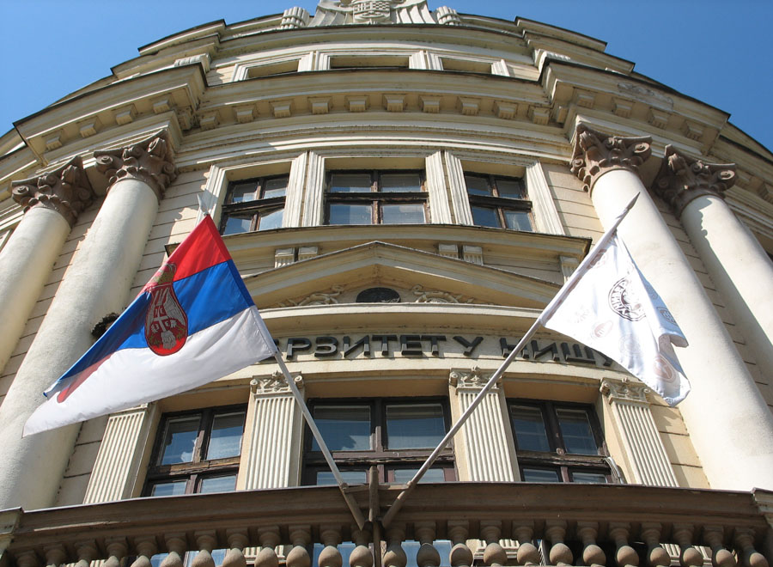
University of Niš
Founded in 1965, June 15th
14 Faculties
70589 graduates (1350 foreign)
7466 postgraduates
2458 Ph.D
130 accredited programs (9 in English)
1601 teaching staff

Slide 6
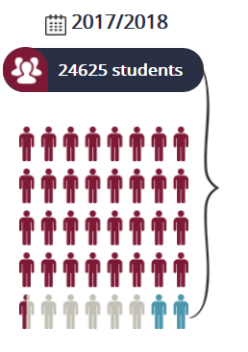
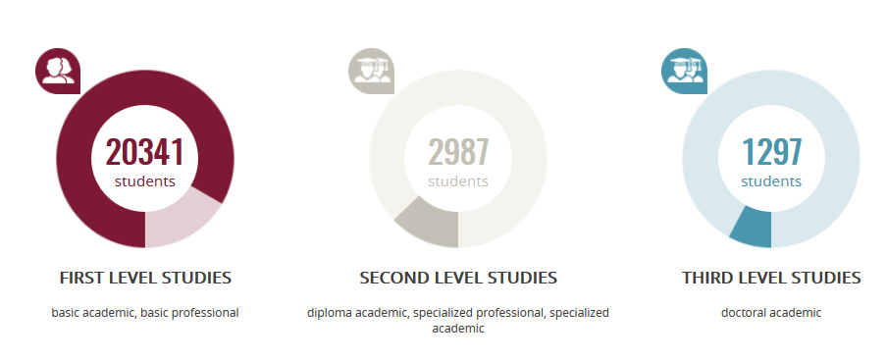
Students

Slide 7
Joint programmes
Convention individuelle, de cotutelle internationale de thèse, entre l’Université de Nis, Serbie et l’Université Lumière Lyon 2, France, 2010.
The agreement on cooperation on doctoral degree education between the Norwegian University of Science and Technology and University of Niš, Serbia, 2012.
Double Degree Master Program in Engineering Science (DDMPES), Agreement on cooperation between Technical University in Berlin, Germany and University of Niš, Serbia, 2012.
Agreement for a Joint Doctoral Research Thesis between the University of Turin, Italy and the University of Niš, Serbia (2016).
PhD School of Mathematics, a joint PhD program in mathematics, 2016.
Doctoral Thesis Co-Supervision (Cotutelle) Agreement between the University of Porto, Portugal and the University of Niš, Serbia (2018).

Slide 8
International Associations and Networks
EUA - European University Association
IUC - Inter-University Center in Dubrovnik
DRC - Danube Rectors' Conference
UniAdrion - Virtual University of the Adriatic-Ionian Basin
EFQUEL - European Foundation of Quality in E-Learning
AARC - Alps-Adriatic Rectors Conference
EEN - Enterprise Europe Network
AUF - Francophone University Association
ASECU - Association of Economic Universities of South and Eastern Europe and the Black Sea Region
SIMERS - COST Action CA15113: Science and Management of
Intermittent Rivers and Ephemeral Streams

Slide 9
International Programmes
TEMPUS: 2001
CEEPUS: 2005
FP7: 2007
IPA: 2007
ERASMUS MUNDUS: 2008
MEVLANA: 2013
HORIZON2020

Slide 10


KA2 Capacity building, KA1 Academic mobility, Jean Monnet
List of projects: https://www.ni.ac.rs/en/international-cooperation/international-programs/erasmus-plus

Slide 11

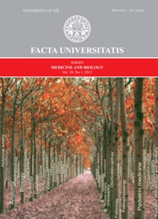
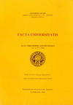
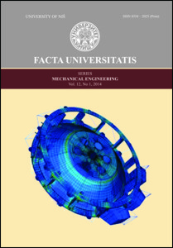
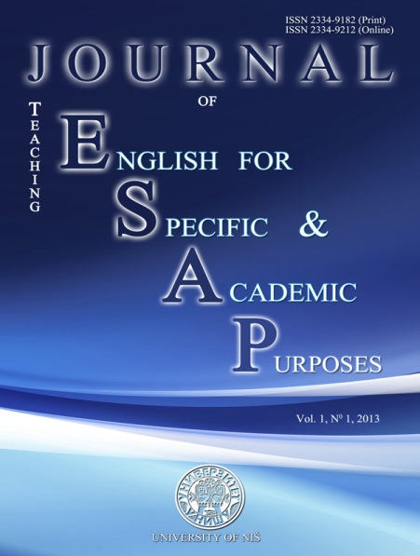
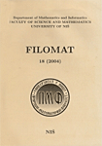
Scientific Journals
Department of Mathematics
FACULTY OF SCIENCES AND MATHEMATICS UNIVERSITY OF NIS
Impact Factor in 2017: 0.635 (SCIe)

Slide 12
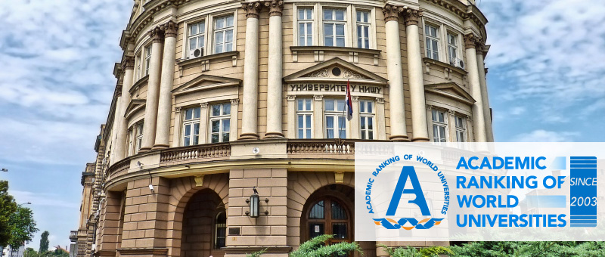
Mathematics 401-500
Chemical engineering 401-500
Sport 151-200

Slide 13

Thank You for Your attention!
https://www.ni.ac.rs/en/

